Slide 1



Department of Computer Science & Engineering
CS3811 Project Work
Academic Year: 2025-26
Zeroth Review -09-09-2025

Slide 2
Federated Machine Learning for Secure and Adaptive
Fuels Theft Detection in Vehicles
Batch Members :
1.Mr.Abdul Rahman A
2.Mr.Bala Subramanian M
3.Mr.Saravanan G
4.Mr.Jenin Raj K
Supervisor:
A.Merry Ida,M.E.,(Ph.D) Assistant Professor, CSE

Slide 3
Overview
  Abstract
  Objective
  Literature Survey
  Summary of Literature
  Proposed System & Novelty
  Block Diagram
  Hardware & Software Requirements
  Base Paper Information
  Reference

Slide 4
Abstract
Problem Statement: Fuel theft is a major economic issue, particularly for commercial fleets, as traditional detection methods are limited.
Proposed Solution: This project introduces a new hybrid system that uses Internet of Things (IoT) sensors and federated machine learning.
Project Goal: The aim is to create a secure, privacy-friendly, and flexible solution for detecting fuel theft in real-time.
Methodology: The system will learn consumption patterns and spot anomalies, avoiding a reliance on fixed thresholds which are often unreliable.
Key Advantage: By learning consumption patterns and detecting anomalies, the system will offer a more effective solution for real-time fuel theft detection.

Slide 5
Objective
Develop a smart, adaptive system to detect fuel theft in vehicles. This system aims to be intelligent and adjust to different conditions to accurately identify theft.
Integrate IoT-based fuel monitoring with a Federated machine learning model to spot theft events. The goal is to combine hardware sensors with a collaborative learning model to improve detection capabilities.
Minimize false alarms by including contextual features and learning typical consumption patterns. This will make the system more reliable by differentiating between normal fuel usage and actual theft.
Send instant theft alerts through a mobile application. The system will notify users immediately when a potential theft event is detected.
Evaluate the model's accuracy, precision, recall, and detection latency. This is to measure the effectiveness and efficiency of the proposed system.

Slide 6
Literature Survey
TITLE | YEAR | AUTHOR | TECHNIQUE
Design and Implementation of Vehicle Theft Prevention by Operating Fuel Injector | 2025 | Siva Ramakrishna Pillutla, Anamika Lata, Praveen Maurya, Manish Kumar Singh, Rambabu Kusuma | Fuel injector operation, Raspberry Pi, Arduino Nano, Wi-Fi module, face detection, and Blynk app for notifications and control.
Vehicle Fuel Theft Detection and Monitoring | 2024 | VASANTH KUMAR, T. GIRISHCHOWDARY, PRAVEEN D B, PAVAN C, SATISH KUMAR B | Digital fuel meter, ultrasonic and flow sensors, buzzer, and GSM module for SMS alerts.
Detecting Fuel Theft with Arduino | 2024 | Adhithya Madhavan, Santhosh Sivan J, Ayyarraja, Mrs. Sheela A | Arduino, fuel level sensor, clip sensor, buzzer, and GSM module to send SMS alerts.
Vehicle Fuel Theft Detection System | 2024 | Adhithya Madhavan, Santhosh Sivan J, Ayyarraja, Mrs. Sheela A | Level sensor, microcontroller, GSM modem, buzzer, ignition key interface, and LCD display.
Fuel Theft Detection System with Automated Calling and Alert Using GSM | 2024 | G Madhusudhana Rao, Kowtharapu Kranthi Kumar, Lakkavaram Ponnuswami Linus, Kummari Sathwik, Karyamsetty Vamsi, Jonnakuti Pavan Charith | GSM technology for automated phone calls and SMS alerts, specialized sensors, and an audible alarm.

Slide 7
Summary of Literature
Traditional methods are flawed in their design. They rely on physical locks or simple sensors that are easily overcome and only detect theft after it has already happened.
Fixed-threshold systems are not effective. These systems frequently produce false alarms because they cannot differentiate between normal fuel usage and actual theft.
Machine learning improves detection accuracy. Advanced models are used to learn normal fuel consumption patterns, which allows for more precise anomaly detection and reduces false alarms.
Federated learning is the new, secure approach. This framework enables a collaborative model to be trained across multiple vehicles while protecting individual data privacy.
The proposed project is highly innovative. It uniquely combines IoT sensors for real-time monitoring with a federated learning framework for a secure, adaptive, and accurate theft detection system.

Slide 8
Proposed System
Hybrid System Architecture: The system is designed as a hybrid solution that combines two key technologies. It integrates an IoT-based fuel monitoring system with a federated machine learning framework.
IoT for Real-time Monitoring: The system will use hardware such as an Arduino, an ultrasonic sensor. These components will enable continuous, real-time monitoring of a vehicle's fuel level and consumption patterns.
Federated Learning for Anomaly Detection: The core of the system's intelligence lies in its federated learning model. This model will learn to detect fuel theft as an anomaly by analyzing patterns from a fleet of vehicles without sending private data to a central server.
Privacy and Security Focus: The system's federated learning framework ensures that raw data remains on the vehicle. This approach prioritizes data privacy and security by preventing sensitive information from being exposed or compromised.

Slide 9
Novelty in Proposed System
Integration of IoT and Federated Learning: The project is novel because it combines an IoT-based fuel monitoring system with a sophisticated machine learning model. This hybrid approach is a significant step beyond existing solutions.
Privacy-Preserving Design: A key innovation is that the system keeps all raw, sensitive data on the vehicle itself. This allows for collaborative learning from a large fleet without compromising individual privacy.
Adaptive Anomaly Detection: The system learns from fuel consumption patterns to identify anomalies, making it more accurate than traditional methods that rely on fixed thresholds. This adaptability allows it to quickly identify new theft techniques.
Collaborative Learning Capability: The federated learning framework enables the model to learn collectively from the entire fleet. This allows for rapid improvements in detection without the risk associated with a centralized data-sharing model.

Slide 10
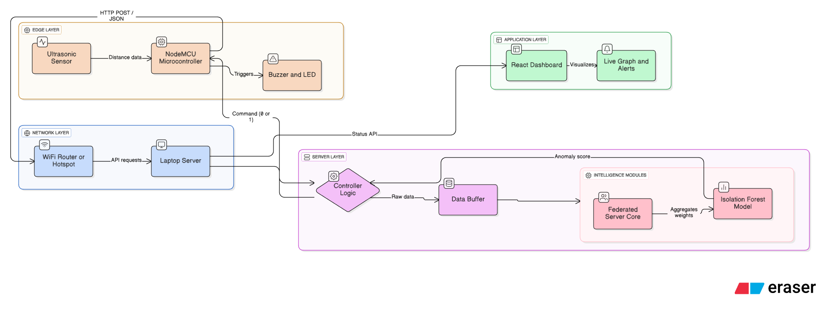
Block Diagram
2

Slide 11
Hardware/Software Requirements
  Hardware Requirements
  NodeMCU ESP8266
  Ultrasonic sensor
  Jumper wires
  Buzzer
  LED
  USB Cable
  Software Requirements
  Isolation Forest Machine Learning
  Federated Machine Learning
  Visual Studio Code
  Arduino IDE
  React.js and Tailwind CSS
  FLASK API
  Postman

Slide 12
Base Paper Information
1. S. Kurundkar, S. Rathod, R. Sapate, S. Raut, and S. Khopade, "Vehicle Fuel Theft Detection System," in 2024 International Conference on Sustainable Communication Networks and Application (ICSCNA), Pune, India, 2024, pp. 1570-1577, doi: 10.1109/ICSCNA63714.2024.10864281.
2. A. Madhavan, S. Sivan J, Ayyarraja, and S. A, "Detecting Fuel Theft with Arduino," in 2024 Second International Conference on Emerging Trends in Information Technology and Engineering (ICETITE), Chennai, India, 2024, pp. 1-6, doi: 10.1109/IC-ETITE58242.2024.10493392

Slide 13
References
Madhusudhana Rao, G., et al. "Fuel Theft Detection System with Automated Calling and Alert Using GSM." International Journal of Innovative Research in Science, Engineering and Technology, 2024.
Chaudhari, Durvesh S., et al. "Fuel Monitoring System Using IoT Device." International Research Journal of Modernization in Engineering Technology and Science, 2024.
Pillutla, Siva Ramakrishna, et al. "Design and Implementation of Vehicle Theft Prevention by Operating Fuel Injector." Third International Conference on Augmented Intelligence and Sustainable Systems (ICAISS), 2025.
Sharma, Rashika A., et al. "IoT Based Fuel Tank Monitoring System." International Research Journal of Modernization in Engineering Technology and Science, 2025.
Deekshitha, R., et al. "Smart Fuel Level Monitoring and Alerting System Based on IoT." Futuristic Trends in IOT, 2024.

Slide 14
References
Madhavan, Adhithya, and Sheela A. "Detecting Fuel Theft with Arduino." Second International Conference on Emerging Trends in Information Technology and Engineering (ICETITE), 2024.
7.Kurundkar, Sangeeta, et al. "Vehicle Fuel Theft Detection System." International Conference on Sustainable Communication Networks and Application (ICSCNA), 2024
8.Mengstie, Berhanu Abnet, and Eden Aragaw Addisu. "Evaluation of Fuel Theft Prevention System with Integrated Sensors." SSRN, 2024.
9.Kumar, Vasanth, et al. "Vehicle Fuel Theft Detection and Monitoring System." Journal of Emerging Technologies and Innovative Research, 2024.
10.Deepika and Sneha H. R. "Smart Fuel Theft Detection and Monitoring System Using IoT with GPS and GSM Integration." Journal of Emerging Technologies and Innovative Research (JETIR), 2025.

Slide 15
Thank
You

